Slide 1
Being smart in business means knowing what’s just around the corner.

Slide 2
It means thinking ahead and preparing for inevitable changes that will impact the way business is conducted.

Slide 3
This is what allows a business to be resilient and to thrive in a changing environment.

Slide 4
Digital marketing is no different.

Slide 5
It’s affecting the way that SEO works, the tools and software we use, and the way that ads are displayed.

Slide 6
The digital marketing singularity is just around the corner.

Slide 7
The mistake that some big businesses make is to assume that they’re too big to fail and to coast along as they are.

Slide 8
As digital marketers, that means thinking about things that could impact on the face of marketing.

Slide 9
Artificial Intelligence (AI) and machine learning have the potential to completely change the face of internet marketing,

Slide 10
rendering many older strategies obsolete even.

Slide 11
And a lot of this stuff isn’t just speculation: it’s happening right now.

Slide 12
Here’s where my advice for you comes in.

Slide 13
With My Advice…
You will gain a crystal ball with which to gaze into the future of internet marketing.
You’ll be better prepared and in a better position than 99.9% of other marketers.
You will examine a large number of different types of AI and machine learning in the context of digital marketing.
You will be ensured that your websites manage to hold their position in the SERPs.
You will create endless amounts of content in a second.

Slide 14
To make it easy, I’ve put together a step-by-step guide that will show you exactly how it’s done...

Slide 15
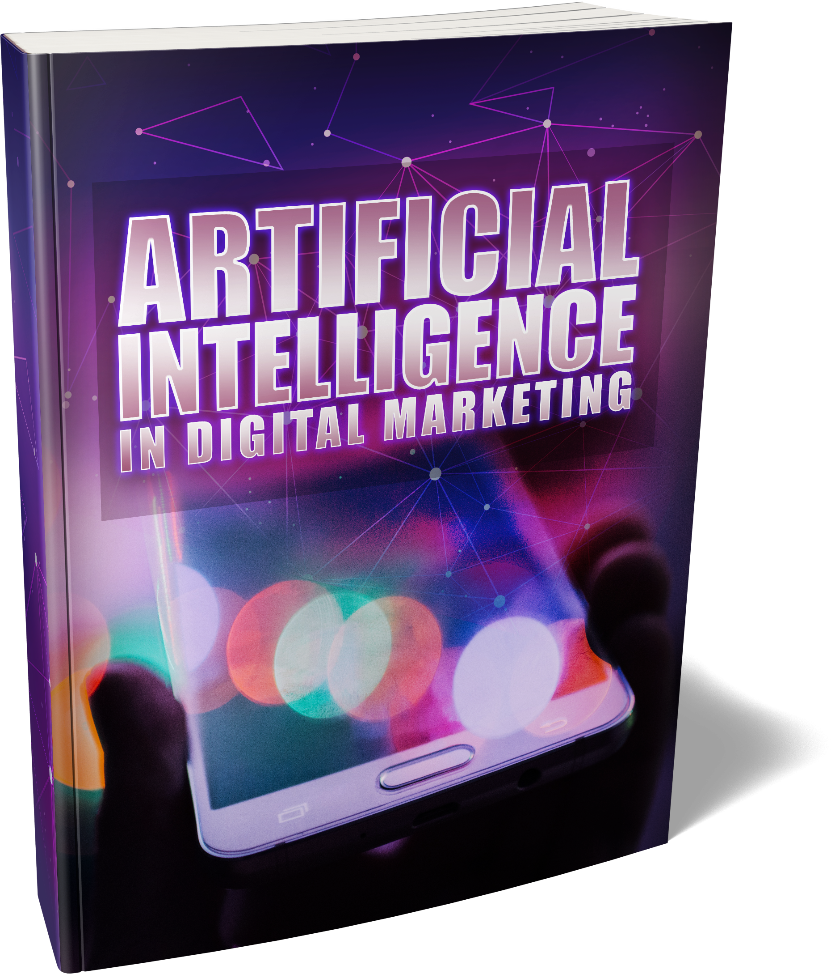
Introducing…

Slide 16
Here’s Just A Quick Preview Of What You’ll Discover Inside...
What Is AI And Machine Learning?
Advertising
Google As An AI-First Company
Email Marketing
Chatbots
Preparing For Semantic Search
Developing Your AI Skills – Using SQL
Big Data
Computer Vision
How To Future Proof Your Marketing

Slide 17
Plus, a whole lot more...

Slide 18
This is the easiest way to actually learn and be ready for Artificial Intelligence in Digital Marketing!

Slide 19
Who Needs This Step-By-Step Guide?

Slide 20
If you answer YES to any of the below, you need this…
You want to ensure that your websites manage to hold their position in the SERPs.
You want your advertising campaigns to remain profitable, and that your services remain relevant.
You want to create endless amounts of content in a second.
You want to be ready for the future of the industry.
You want to know the different types of AI and machine learning in the context of digital marketing.

Slide 21
Does This Sound Like Exactly What You Need? But maybe your next question is: How Much?

Slide 22
If you were going to hire an expert on this, to show you how it’s done,

Slide 23
you could easily find yourself investing hundreds of dollars for this sort of coaching.

Slide 24
In fact, many people invest hundreds and thousands of dollars to get into coaching programs or attend workshops...

Slide 25
But, you won’t have to invest anywhere near that today.

Slide 26
And it just keeps getting better…

Slide 27
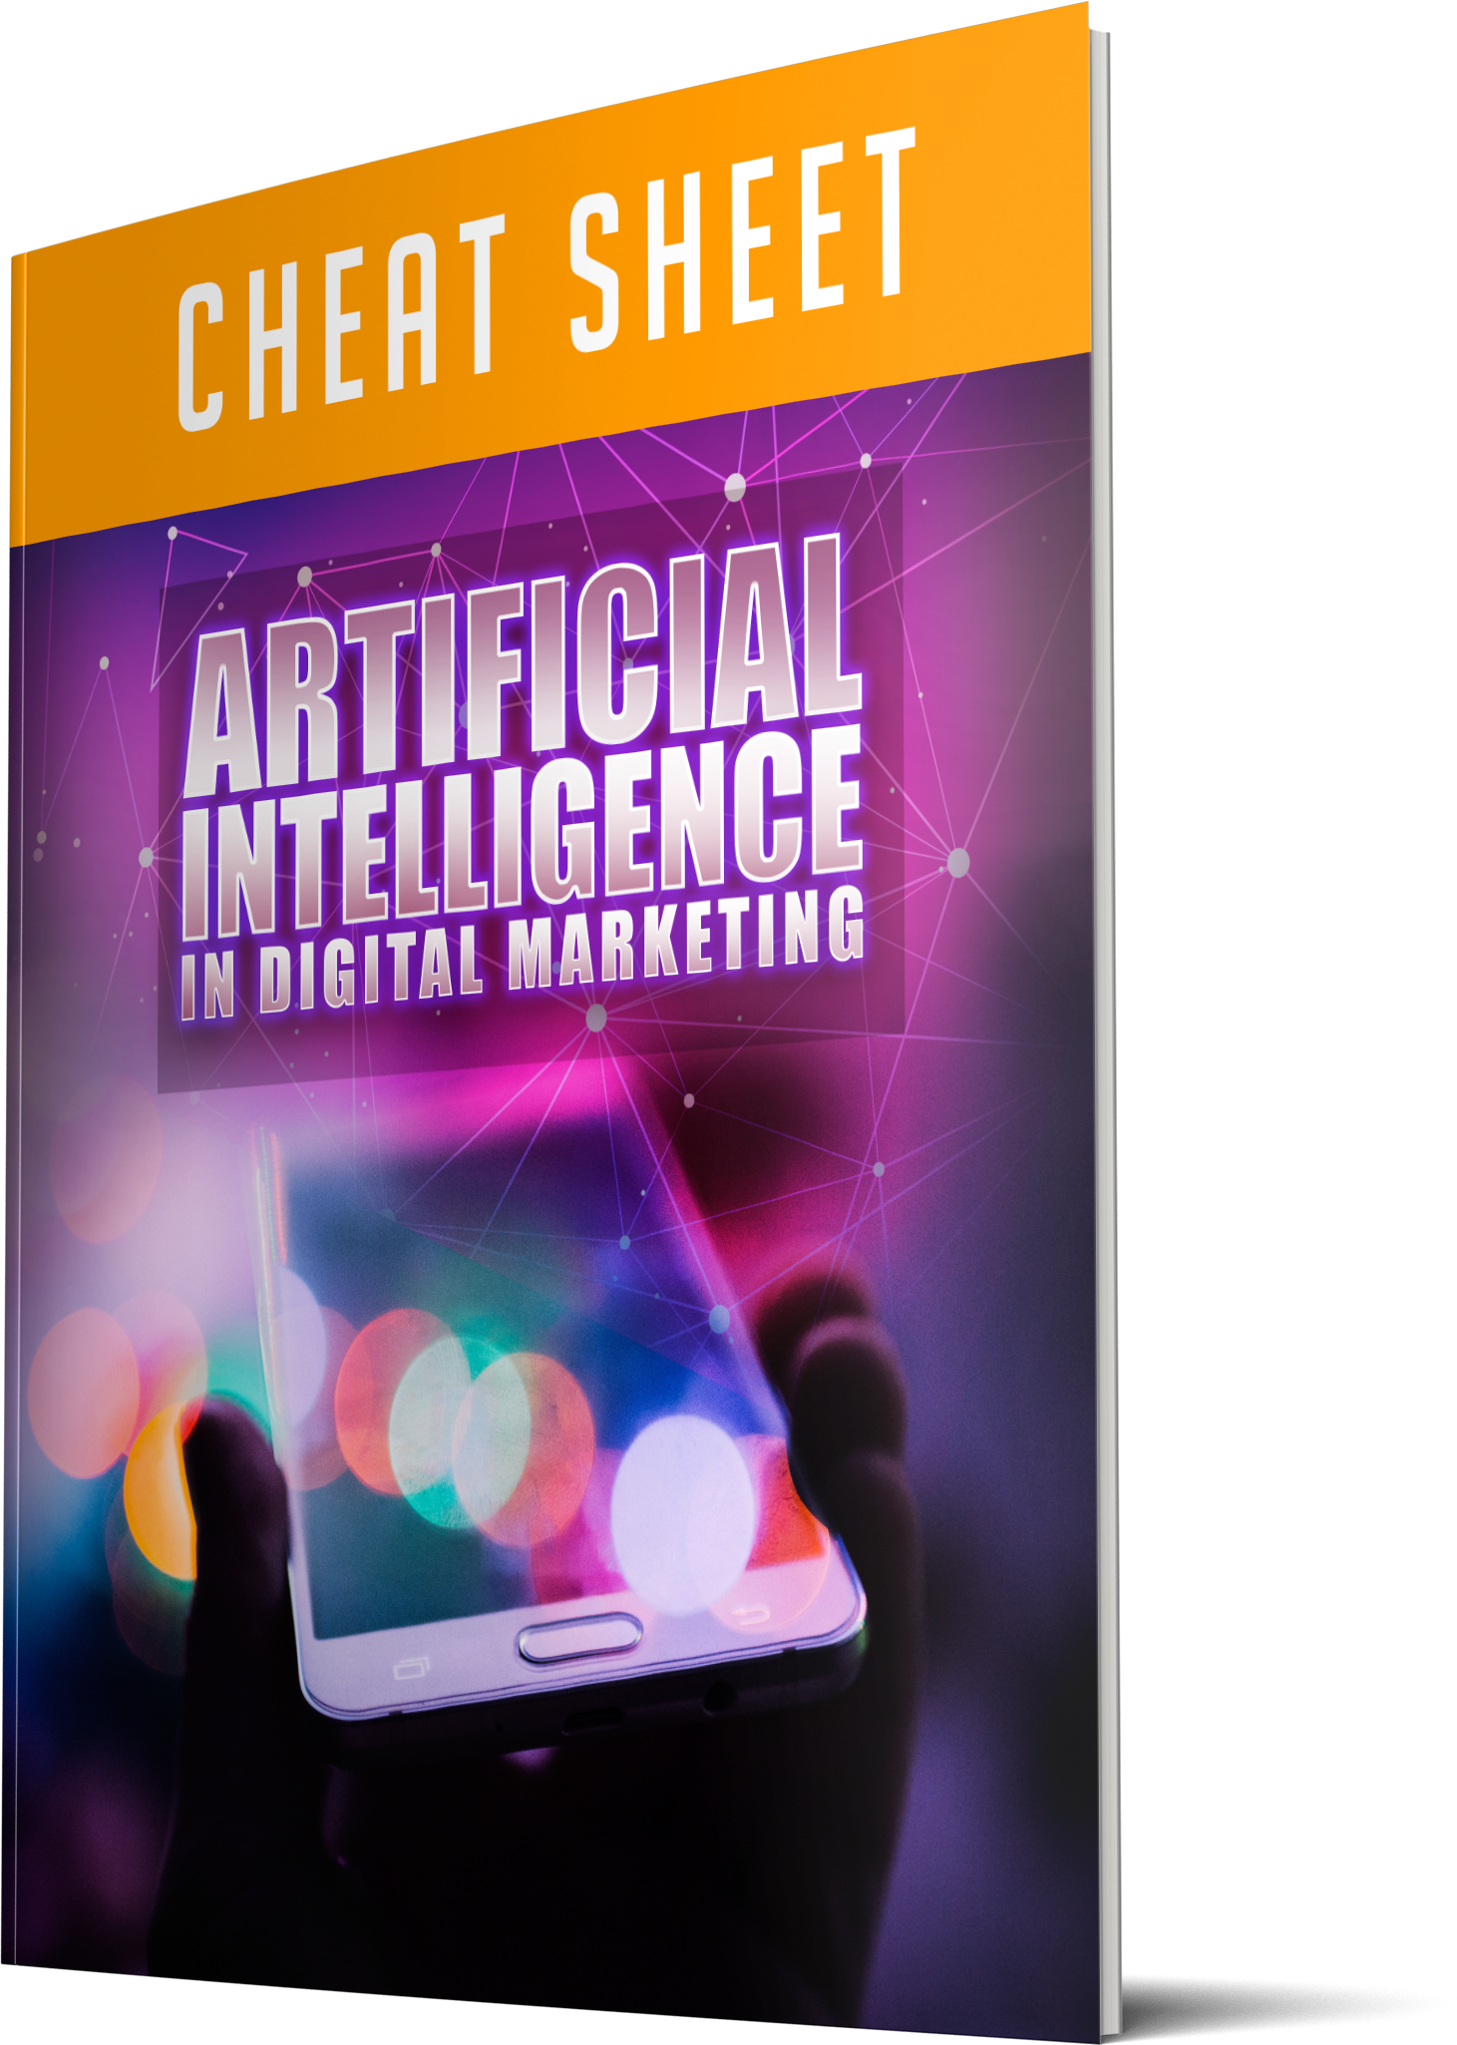
When You Make The Wise Decision To Grab This Today, You’ll Also Get These Fast Action Bonuses…
Fast Action Bonus #1 – Artificial Intelligence In Digital Marketing – Cheat Sheet (Valued at $27)

Slide 28
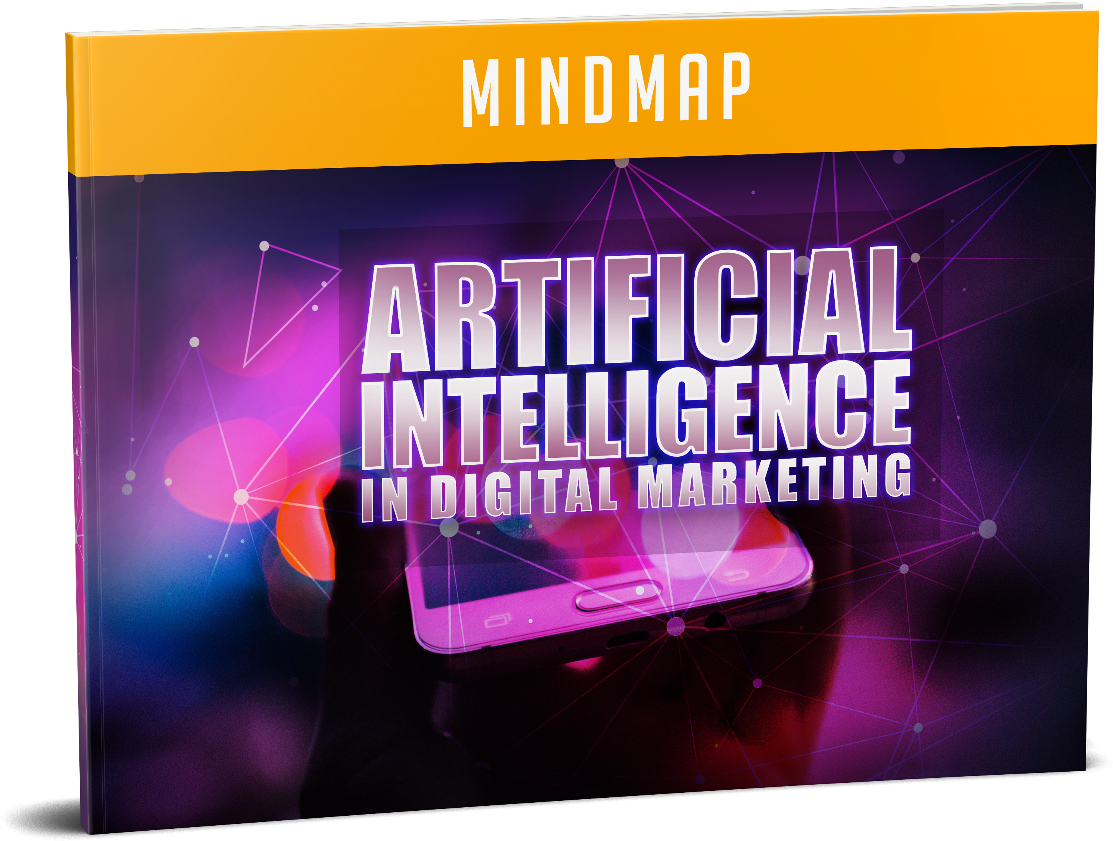
When You Make The Wise Decision To Grab This Today, You’ll Also Get These Fast Action Bonuses…
Fast Action Bonus #2 – Artificial Intelligence In Digital Marketing – Mind Map (Valued at $17)

Slide 29
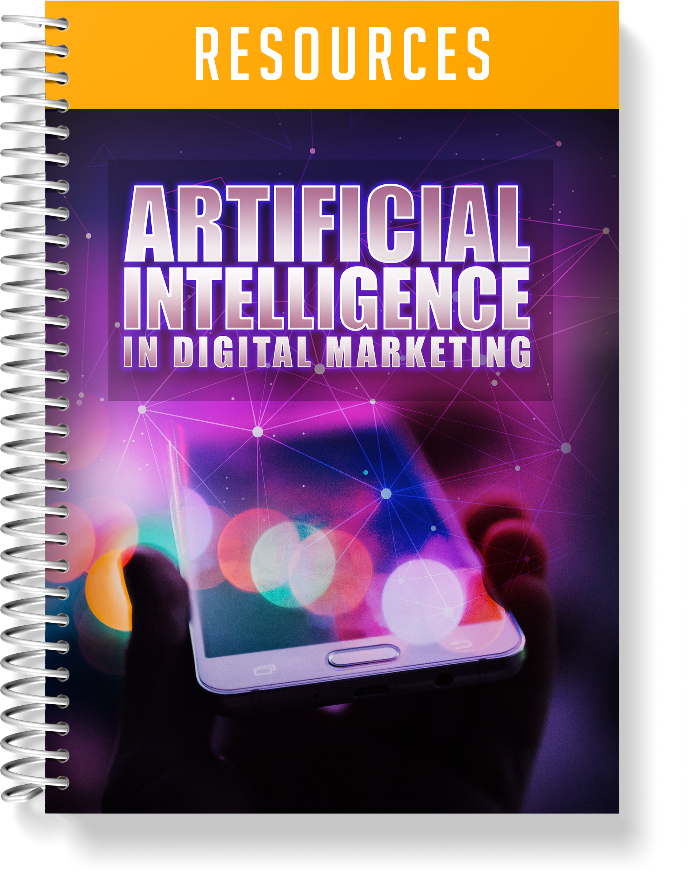
When You Make The Wise Decision To Grab This Today, You’ll Also Get These Fast Action Bonuses…
Fast Action Bonus #3 – Artificial Intelligence In Digital Marketing – Resource Guide (Valued at $17)

Slide 30
Try This Guide On MY DIME… There’s No Risk!

Slide 31
There are a lot of people that claim to offer a solution to learn and be ready for Artificial Intelligence in Digital Marketing,

Slide 32
so it’s understandable if you’re a little skeptical.

Slide 33
I can keep telling you just how great my guide is,

Slide 34
but you really need to go through it and see for yourself what it’s all about to know if it’s for you…

Slide 35
That’s why I’m going to give you a FULL 30 days to decide if this is for you…

Slide 36
If for any reason, or no reason at all, you’re not 100% satisfied with what’s inside,

Slide 37
simply send me an email, and I’ll refund every penny of your tiny investment…

Slide 38
No questions asked!

Slide 39
Click The Button Below Now To Get INSTANT ACCESS…

